Slide 1


KARNATAKA UNIVERSITY, DHARWAD
UNIVERSITY WITH POTENTIAL FOR EXCELLENCE
GOVERNMENT FIRST GRADE COLLEGE YELLAPUR
Uttara Kannada - 581359
A Financial Analysis Report On
“Ratio Analysis: Evaluating Karnataka Bank Ltd.’s Financial Health for Individual Investors”
Presented By: Savitri Mahabaleshwara Bhat
Reg. No.: U02IU21C0020
Under The Guidance Of
Mr. Sharath Kumar
Assistant Professor
Department of Commerce
1 of 16

Slide 2
Overview Of The Study
What, Why and How are Shares?
Who, Why and What will You gain by investing in Shares?
Objectives Of The Study
Providing actionable insights for investors to make informed decisions regarding investment in the equity shares of Karnataka Bank Ltd.
This report also aims to justify the statement “Absolute values are not enough for investors; that is why we compute ratios”
Scope Of The Study
Research Methodology
Limitations Of The Study
2 of 16

Slide 3
Why are the financial figures necessary to invest?
What is Financial Statements?
What is the Purpose Of Financial Statement Analysis?
What are the Techniques To Measure Financial Performance?
Why Is Ratio Analysis Important?
3 of 16

Slide 4
What are the financial figures necessary to invest in REITs?
Provisioning Coverage Ratio
Capital Adequacy Ratio
Current Account Saving Account Ratio
Net Interest Margin Ratio
Price to Book Ratio
Return on Equity Ratio
Earnings Per Share Ratio
Debt to Equity Ratio
Dividend Yield
Price to Earnings Ratio
Tier-1 Leverage Ratio
Loans to Deposit Ratio
Cost to Income Ratio
Return on Assets Ratio
Net Profit Margin Ratio
Gross Non-performing Assets Ratio
Net Non-performing Assets Ratio
4 of 16

Slide 5


Karnataka Bank Ltd.
“Your Family Bank Across India”
History
Vision and Mission
Services Offered
Listing And Shareholding
Closing Share Price on 8th July
₹ 220.73
5 of 16

Slide 6
Data Analysis, Interpretation and Findings
Provisioning Coverage Ratio
Capital Adequacy Ratio
6 of 16

Slide 7
Data Analysis, Interpretation and Findings
Current Account Saving Account Ratio
Net Interest Margin Ratio
7 of 16

Slide 8
Data Analysis, Interpretation and Findings
Price to Book Ratio
Return on Equity Ratio
8 of 16

Slide 9
Data Analysis, Interpretation and Findings
Earnings Per Share Ratio
Debt to Equity Ratio
9 of 16

Slide 10
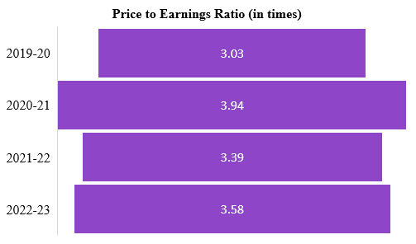
Data Analysis, Interpretation and Findings
Dividend Yield
Price to Earnings Ratio
10 of 16

Slide 11
Data Analysis, Interpretation and Findings
Tier-1 Leverage Ratio
Loans to Deposit Ratio
11 of 16

Slide 12
Data Analysis, Interpretation and Findings
Cost to Income Ratio
Return on Assets Ratio
12 of 16

Slide 13
Data Analysis, Interpretation and Findings
Net Profit Margin Ratio
Gross Non-performing Assets Ratio
13 of 16

Slide 14
Data Analysis, Interpretation and Findings
Net Non-performing Assets Ratio
14 of 16

Slide 15
Suggestions and Conclusion
Invest for long term.
Consider dividend income.
Continue monitoring PCR, GNPA and NNPA ratios for potential risks.
Estimate risk management continuously.
Keep an eye on interest rate changes.
Monitor operational efficiency (cost to income ratio).
Diversify portfolio, which minimize risk and maximize returns.
Keep an eye on the financial health by evaluating liquidity, solvency and profitability
Evaluate the impact of economic cycles.
Evaluate market conditions and the bank’s competitors.
“Absolute values are not enough for investors; that is why we compute ratios”
15 of 16
Reg No: U02IU21C0022, Shweta Hegde

Slide 16
Thank You
16 of 16

